Slide 1
ultraviolent junglist
ultraviolent electronic music workstation

Slide 2
ideas
2 modes – maybe even 2 apps?
Edit
Live
(pseudo) random selecting parts of samples
Playing multiple tracks

Slide 3
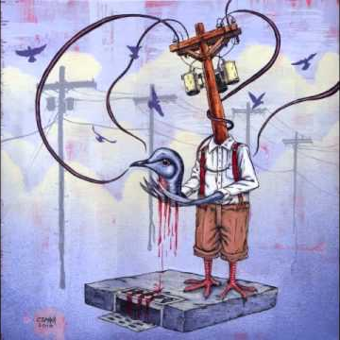
color scheme
#1a0f24
#eae6d9
#9f2a55
#d5daf6
#4f4584
inspiration

Slide 4
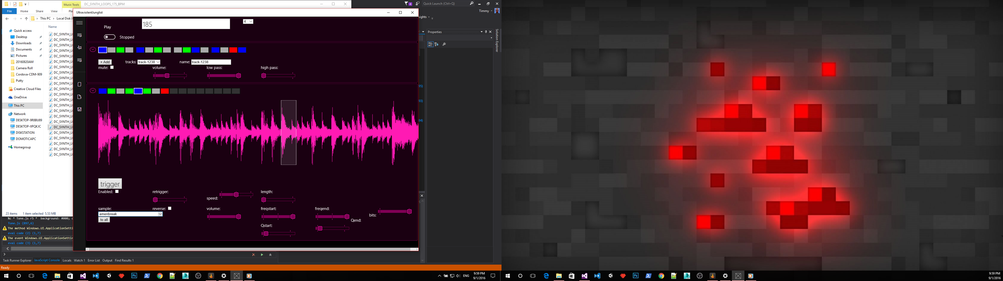
atomic design
patternlist
track
asdasdasdasdasd
asdasd asda dasd ada
Yukiuin ikuikikiuk
Track name
sample

Slide 5
Song editor
Pattern editor
Track editor
Sample editor
FX editor

